Slide 1
Interrupts, Traps and Exceptions
CS 2200 Fall 2023

Slide 2
Interrupts, Traps and Exceptions
Interrupts, traps and exceptions are discontinuities in program flow
Students asking a teacher questions in a classroom is a good analogy to the handling of discontinuities in program flow
Are you beginning to notice the need for partnership between system hardware and software?

Slide 3
Discontinuities in program execution
We must first understand
Synchronous events: Occur at well defined points aligned with activity of the system
Making a phone call
Opening a file
Asynchronous events: Occur unexpectedly with respect to ongoing activity of the system
Receiving a phone call
A user presses a key on a keyboard

Slide 4
Discontinuities in program execution
There is no universally accepted set of definitions for interrupts, traps and exceptions so we will use these
Interrupts: Asynchronous events usually produced by I/O devices which must be handled by the processor by interrupting execution of the currently running process
Traps: Synchronous events produced by special instructions typically used to allow secure entry into operating system code
Exceptions: Synchronous events usually associated with software requesting something the hardware can’t perform i.e. illegal addressing, illegal op code, etc.

Slide 5
4.1 Discontinuities in program execution
Type | Sync/Async | Source | Intentional? | Examples
Exception | Sync | Internal | No | Overflow, Divide by zero, Illegal memory address
Trap | Sync | Internal | Yes and No | System call, Page fault, Emulated instructions
Interrupt | Async | External | Yes | I/O device completion

Slide 6
An example of a trap is…
Keyboard input
System call to open a file
Divide by zero
Arithmetic overflow
High speed I/O
This question is a trap
10

Slide 7
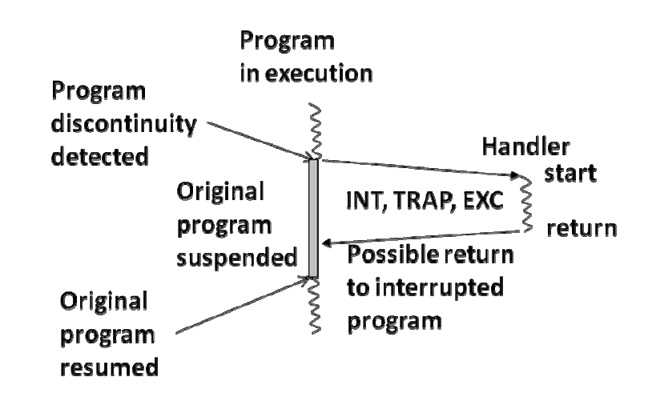
Execution path

Slide 8
New internal processor register
Exception/Trap number
ETR
Will contain a unique number stashed by the hardware to indicate the type of discontinuity

Slide 9
Handler code for divide by zero exception
Interrupt Vector Table
0
Handler address
for divide by zero exception
Handler code for overflow exception
1
Handler address
for arithmetic overflow
Table entries for
exceptions
……..
Handler code for system call trap
.
.
.
.
.
.
.
.
Handler address
for system call trap
Table entries for
traps
Handler address
for page fault trap
Handler code for page fault trap
……..
Handler address
for KBD interrupt
Handler code for KBD interrupt
Table entries for
External interrupts
Handler address
for mouse interrupt
………
Handler code for mouse interrupt
n-1

Slide 10
Dealing with program discontinuities
Can happen anywhere even in the middle of an instruction execution.
Unplanned for and forced by the hardware. Hardware has to save the program counter since we are jumping to the handler.
Address of the handler is unknown. Therefore, hardware must manufacture an address.
Since hardware saved the PC, handler has to discover where to return upon completion.

Slide 11
Architectural enhancements to handle program discontinuities
When should the processor handle an interrupt?
How does the processor know there is an interrupt?
How do we save the return address?
How do we manufacture the handler address?
How do we handle multiple cascaded interrupts?
How do we return from the interrupt

Slide 12
Modifications to FSM
Where should we take an interrupt?
Fetch
Decode
Execute
int = 0
INT
int = 1
Interrupt:
$k0 ← PC
PC ← new PC
An additional macro state

Slide 13
What needs to happen in microcode?
INT Macro State:
$k0 ← PC
ETR ← ID of interrupting device on bus
PC ← Mem[ETR]
(Not the full picture yet, FYI)

Slide 14
What needs to happen in software?
Handler:
save processor registers;
execute device code;
restore processor registers;
return to original program;
(Not the full picture yet, FYI)

Slide 15
That's great, but…
There are a couple of rubs.
What happens when an interrupt handler takes an interrupt?

Slide 16
Handling cascaded interrupts
Original
Program
Original
Return
Address
$k0←
First
Interrupt
Handler
First
Handler
Return
Address
←
$k0
Second
Interrupt
Handler

Slide 17
What needs to happen …
Handler:
save processor registers (including $k0);
execute device code;
restore processor registers (including $k0);
return to original program;

Slide 18
That's great, but…
There are a couple of rubs.
What happens when an interrupt handler takes an interrupt?
OK. That's better. Save/restore $k0 in the handler.
But one more little thing…
What happens if the second interrupt hits before we save $k0?

Slide 19
What needs to happen …
Handler:
save processor registers (including $k0);
execute device code;
restore processor registers (including $k0);
return to original program;
What if an interrupt happens here?
No problem. We'll save $k0 first
How many instructions does it take to push a register on the stack?

Slide 20
What needs to happen …
Handler:
save processor registers (including $k0);
execute device code;
restore processor registers (including $k0);
return to original program;
Store $k0 first.
It takes •Decrement $sp
•Store $k0,0($sp)
What if the interrupt happens after the Decrement!?!?

Slide 21
What are we lacking?
We don't have a way to prevent an interrupt from happening between certain instructions
In other words, we need for groups of machine instructions to behave atomically – i.e. as if they all were executed as a single instruction
How could we do that?
We could turn off interrupts between instructions?

Slide 22
The plan
Create a new processor register, IE, that is 1 when interrupts are enabled
For an interrupt to be recognized, i.e. for the microcode to advance to the INT macro state, an interrupt must be asserted AND IE must be 1
In the INT macro state, turn off IE before fetching the first instruction in the handler
We need two more instructions: EI and DI to respectively set IE to 1 and 0.
Use EI after pushing $k0 on the stack

Slide 23
Handling cascaded interrupts
Fetch
Decode
Execute
int = 0 | IE = 0
INT
int = 1 & IE = 1
Add 2 new instructions
Enable Ints
Disable Ints
Interrupt:
$k0 ← PC
PC ← new PC
Disable Ints

Slide 24
What term can we use for the situation in which the two-instruction push of $k0 is interrupted by another interrupt
Deadlock
Race condition
Program exception
Excessive interrupts
Cascaded interrupts
Todays’ number is 67,131
15

Slide 25
Yay! This will work perfectly!
Handler:
save $k0; enable interrupts
save processor registers;
execute device code;
restore processor registers;
disable interrupts; restore $k0; enable interrupts;
return to original program;
Or does it?
What if an interrupt occurs here?

Slide 26
Returning from the handler
Returning involves jumping to the address in $k0 which can be accomplished with
jalr $k0, $zero
But as we have just seen an interrupt at precisely the wrong moment would destroy $k0 and cause a failure
What do we need?
All this needs to be atomic, too!
restore $k0;
enable interrupts
return to original program;

Slide 27
Returning from the handler
So we need another new instruction, RETI
It atomically enables interrupts and sets the PC to return from the handler
RETI: PC ← $k0 EI ← 1

Slide 28
Now we can handle cascaded interrupts
Fetch
Decode
Execute
int = 0 | EI = 0
INT
int = 1 & EI = 1
Add 3 new instructions
Enable Ints
Disable Ints
Return from interrupt
Interrupt:
$k0 ← PC
PC ← new PC
Disable Ints

Slide 29
Summary of architectural enhancements to LC-2200 to handle interrupts (so far)
Three new instructions to LC-2200:
Enable interrupts
Disable interrupts
Return from interrupt
Upon an interrupt, store the current PC implicitly into a special register $k0, disable interrupts, and set the PC to the address of the handler
Upon returning from an interrupt (RETI), store $k0 into the PC and enable interrupts.

Slide 30
Reminder: Levels of Abstraction
Application (Algorithms expressed in High Level Language)
System software (Compiler, OS, etc.)
Computer Architecture (ISA)
Machine Organization - Control
Machine Organization - Datapath
Sequential and Combinational Logic Elements
Logic Gates
Transistors
Solid-State Physics (Electrons and Holes)

Slide 31
Reminder: Levels of Abstraction
System software (Compiler, OS, etc.)
Computer Architecture (ISA)
Machine Organization - Control
Machine Organization - Datapath
Sequential and Combinational Logic Elements

Slide 32
Reminder: Levels of Abstraction
System software (Compiler, OS, etc.)
Computer Architecture (ISA)
Machine Organization – Control
Machine Organization - Datapath
Sequential and Combinational Logic Elements

Slide 33
An Interrupt Appears: Step 1
System software (Compiler, OS, etc.)
Computer Architecture (ISA)
Machine Organization - Control | Notice the interrupt and change microcode state Save PC in $k0 Set PC to handler address Disable interrupts Set state to ifetch1
Machine Organization - Datapath
Sequential and Combinational Logic Elements

Slide 34
An Interrupt Appears: Step 2
System software (Compiler, OS, etc.)
Computer Architecture (ISA) | Handler: push $k0 onto stack Enable interrupts Save processor registers Run device code Restore registers Disable interrupts Restore $k0 from stack Executes RETI instruction
Machine Organization - Control | Run FETCH DECODE EXECUTE loop as usual
Machine Organization - Datapath
Sequential and Combinational Logic Elements

Slide 35
An Interrupt Appears: Step 3
System software (Compiler, OS, etc.)
Computer Architecture (ISA)
Machine Organization - Control | Transfer $k0 to PC Enable interrupts Go back to ifetch1
Machine Organization - Datapath
Sequential and Combinational Logic Elements

Slide 36
An Interrupt Appears: Back to Normal
System software (Compiler, OS, etc.)
Computer Architecture (ISA) | Resume executing user program instructions precisely where we left off
Machine Organization - Control | Run FETCH DECODE EXECUTE loop as usual
Machine Organization - Datapath
Sequential and Combinational Logic Elements

Slide 37
Hardware details for handling external interrupts
What we have presented thus far is what is required for interrupts, traps and exceptions
What do we need specifically for external interrupts?

Slide 38
Wiring for external interrupts
Processor
Data Bus
INT
INTA
Device 1
Device 2

Slide 39
What happens at an interrupt?
Device asserts the INT bus (it’s wired so multiple devices can do this simultaneously)
At the completion of the current instruction, CPU sees INT signal and microcode cycles into the INT macro state
Microcode raises the INTA signal line
Devices pass-through the INTA signal if they are not interrupting; otherwise the first interrupting device asserts its ID on the data bus
Microcode reads the data bus and uses the ID as an index to determine which entry in the IVT to use to set the PC

Slide 40
Multiple interrupt priority levels
INT8
INTA 8
Device 1
Device 2
.
.
.
.
.
.
.
.
Priority
Encoder
Processor
INT
INT1
INTA
INTA 1
Device 1
Device 2

Slide 41
Priority encoder
A priority encoder takes 2^{n} inputs and produces a 1-bit INT output and an n-bit ID output.
If any of the input lines is high, the PE asserts the INT output
The PE asserts the encoded value of the first high input line onto the ID output
E.g. if input 5 and 7 are high on a 3-bit PE, then it asserts INT and ID=101
If only input 7 is high, then it asserts INT and ID=111

Slide 42
Address of handler
KEYBOARD
80
81
….
Address of handler
MOUSE
82
83
….
Memory
.
.
.
.
Interrupt vector table
Processor
Data Bus
INT
INTA
Device 1
Device 2

Slide 43
Where to save/restore CPU registers in the interrupt handler
The user stack?
Bad idea. The user doesn’t even have to set $sp if he doesn’t feel like it. Bad practice, but real possibility.
Where, then?
How about we let the OS have a system stack that we know is handled properly?

Slide 44
Stack for saving/restoring
Hardware has no guarantee for stack behavior by user program (register/conventions)
Equip processor with 2 saved stack pointers (User/System)
On interrupt, save user stack pointer from $sp and restore the system stack pointer to $sp
We’ll need two more registers, USP and SSP
$sp
2
1
SSP
USP

Slide 45
Stack for saving/restoring
Use system stack for saving all necessary information
Upon completion of interrupt restore registers, etc.
The restore user stack pointer by reversing earlier swap
Keep a user/kernel mode flag to record whether we’re using the user or kernel stack
$sp
1
2
SSP
USP

Slide 46
Stacks and modes during interrupts
User program
handler1
handler2
what mode?
Mode user
User stack
INT
what mode?
Mode kernel
Kernel stack
which stack?
INT
what mode?
Mode kernel
Kernel stack
which stack?
RETI
what mode?
Mode kernel
RETI
Kernel stack
which stack?
what mode?
Mode user
User stack
which stack?

Slide 47
How do we get between these macro-states?
Fetch
Decode
Execute
int = 0 | IE = 0
INT
int = 1 & IE = 1

Slide 48
Microcode interrupt actions
INT macro state:
$k0 ← PC
Assert INTA to acknowledge interrupt
Receive IV (interrupt vector) from the device on the data bus
PC ← Mem[IV]
Push mode on stack
if user mode,
USP ← $sp; $sp ← SSP
mode ← kernel
Disable interrupts
RETI instruction:
PC ← $k0
Pop mode from system stack
if user mode,
SSP ← $sp; $sp ← USP
Enable interrupts

Slide 49
A working interrupt handler
Handler: // handler starts with interrupts disabled push $k0 onto system stack; enable interrupts;
save processor registers to system stack;
execute device code;
restore processor registers from system stack;
disable interrupts; pop $k0 from system stack; // handler ends with interrupts disabled return to original program using RETI;

Slide 50
What instructions do we use to save $k0 on the system stack?
addi $sp,$sp,-1 sw $k0,0($sp)
sw $k0,0($sp) addi $sp,$sp,-1
sw $k0,-1($sp) addi $sp,$sp,-1
jalr save,$ra
nand $r0,$r0,$zero addi $r0,$r0,1 add $sp,$sp,$ro sw $k0,0($sp)
Today’s number is 82,864
20

Slide 51
Why does the interrupt handler disable and then enable interrupts during its execution?
To prevent overheating the interrupt datapath
The I/O device won’t behave properly if interrupts are disabled in the handler
It prevents the saving and restoring of the processor registers from being interrupted
It allows the interrupt handler to be interrupted outside the time it is safely saving/restoring $k0
None of the above
30

Slide 52
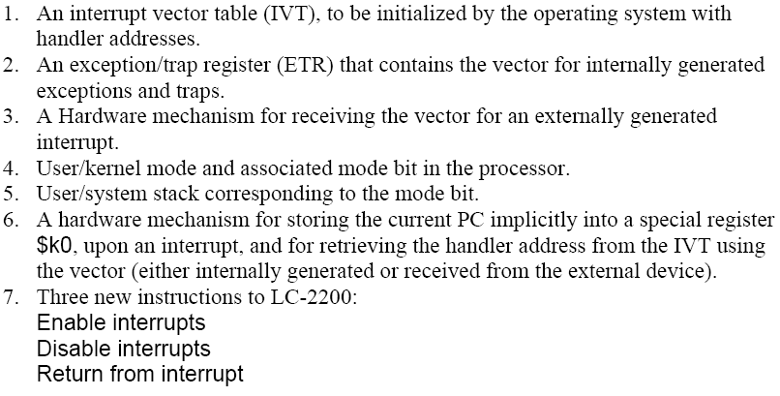
Architecture enhancements to LC-2200 for interrupts

Slide 53
Putting it all together
A.
INT REQ
1
MODE
USER
Executing instruction at 19999. The PC has already been incremented. Device signals interrupt in middle of instruction. $sp points to user stack
INT ACK
0
Register File
INT Enable
1
$k0
300
PC
20000
$sp
user
stack
ADDR
40
41
•
•
•
299
300
•
•
•
1000
1001
•
•
•
19999
20000
CONT
1000
...
...
...
inst
inst
inst
inst
Vector Table
System Stack
Handler Code
Original Program

Slide 54
Putting it all together
B.
INT REQ
1
MODE
USER
Interrupt has been noticed. $k0 gets PC. Interrupts are disabled. Interrupt is acknowledged. Device puts vector on bus.
INT ACK
√
Register File
1
INT Enable
√
$k0
20000
0
BUS
√
$sp
user
stack
40
PC
20000
ADDR
40
41
•
•
•
299
300
•
•
•
1000
1001
•
•
•
19999
20000
CONT
1000
...
...
...
inst
inst
inst
inst
Vector Table
System Stack
Handler Code
Original Program

Slide 55
Putting it all together
MODE
√
C.
Handler address is put into PC; $sp now points to system stack;
Current mode is saved in system stack; New mode is set to kernel; Interrupt code at 1000 is set to handle the interrupt.
INT REQ
0
KERNEL
INT ACK
0
Register File
INT Enable
0
$k0
20000
√
$sp
√
PC
1000
299
ADDR
40
41
•
•
•
299
300
•
•
•
1000
1001
•
•
•
19999
20000
CONT
√
√
1000
...
USER
...
inst
inst
inst
inst
Vector Table
System Stack
Handler Code
Original Program

Slide 56
Putting it all together
MODE
√
D.
INT REQ
0
USER
RETI instruction restores mode from system stack; since returning to user program in this example, sets Mode to User; $sp now points to user stack; also, copies $k0 into PC, re-enables interrupts
INT ACK
0
Register File
INT Enable
√
$k0
20000
1
PC
√
$sp
user
stack
20000
√
ADDR
40
41
•
•
•
299
300
•
•
•
1000
1001
•
•
•
19999
20000
CONT
1000
...
...
...
inst
inst
inst
inst
Vector Table
System Stack
Handler Code
Original Program

Slide 57
A.
Executing instruction at 19999. The PC has already been incremented. Device signals interrupt in middle of instruction. $sp points to user stack
INT REQ
1
MODE
USER
INT ACK
0
Register File
INT Enable
1
$k0
300
PC
20000
$sp
user
stack
ADDR
40
41
•
•
•
299
300
•
•
•
1000
1001
•
•
•
19999
20000
CONT
1000
...
...
...
inst
inst
inst
inst
Vector Table
System Stack
Handler Code
Original Program
B.
INT REQ
1
MODE
USER
Interrupt has been sensed. $k0 gets PC. Interrupts are disabled. Interrupt is acknowledged. Device puts vector on bus.
INT ACK
1
Register File
INT Enable
0
$k0
20000
BUS
40
PC
20000
$sp
user
stack
ADDR
40
41
•
•
•
299
300
•
•
•
1000
1001
•
•
•
19999
20000
CONT
1000
...
...
...
inst
inst
inst
inst
Vector Table
System Stack
Handler Code
Original Program
C.
Handler address is put into PC;
Current mode is saved in system stack; New mode is set to kernel; $sp now points to system stack; Interrupt code at 1000 is set to handle the interrupt.
INT REQ
0
MODE
KERNEL
INT ACK
0
Register File
INT Enable
0
$k0
20000
PC
1000
$sp
299
ADDR
40
41
•
•
•
299
300
•
•
•
1000
1001
•
•
•
19999
20000
CONT
1000
...
...
mode
inst
inst
inst
inst
Vector Table
System Stack
Handler Code
Original Program
D.
INT REQ
0
MODE
USER
RETI instruction restores mode from system stack; since returning to user program in this example, $sp now points to user stack; also, copies $k0 into PC, re-enables interrupts and sets Mode to User
INT ACK
0
Register File
INT Enable
1
$k0
20000
PC
20000
$sp
user
stack
ADDR
40
41
•
•
•
299
300
•
•
•
1000
1001
•
•
•
19999
20000
CONT
1000
...
...
...
inst
inst
inst
inst
Vector Table
System Stack
Handler Code
Original Program

Slide 58
Summary
Interrupts help a processor communicate with the outside world.
An interrupt is a specific instance of program discontinuity.
Processor/Bus enhancements included
Three new instructions
User stack and system stack pointers
Mode bit
INT macro state
Control lines called INT and INTA

Slide 59
Summary
Software mechanism needed to handle interrupts; traps and exceptions are similar.
Discussed how to write a generic interrupt handler that can handle nested interrupts.
Intentionally simplified. Interrupt mechanisms in modern processors are considerably more complex. For example, modern processors categorize interrupts into two groups: maskable and non-maskable.
maskable: Interrupts that can be temporarily turned off
Non-maskable: Interrupts that cannot be turned off

Slide 60
Summary
Presented mode as a characterization of the internal state of a processor. Intentionally simplistic view.
Processor state may have a number of other attributes available as discrete bits of information (similar to the mode bit).
Modern processors aggregate all of these bits into one register called processor status word (PSW).
Upon an interrupt and its return, the hardware implicitly pushes and pops, respectively, both the PC and the PSW on the system stack.
The interested reader is referred to more advanced textbooks on computer architecture for details on how the interrupt architecture is implemented in modern processors.

Slide 61
Summary
Presented simple treatment of the interrupt handler code to understand what needs to be done in the processor architecture to deal with interrupts. The handler would typically do a lot more than save processor registers.
LC-2200 designates a register $k0 for saving PC in the INT macro state. In modern processors, there is no need for this since the hardware automatically saves the PC on the system stack.

Slide 62
Questions?

